Slide 1
Data and Model Quality (QA for ML)
Christian Kaestner

Slide 2
Administrativa
Participation grades
Homework assignments I4 and G2
Teamwork survey

Slide 3
Methods and Qualities
Methods
Dynamic Analysis
Static Analysis
Metrics
Manual Testing
Unit Testing
System Testing
Instrumen-tation
Inspection
Data-Flow Analysis
Model checking
Formal Verification
Black Box
White box
Random
Qualities
Quality in use
Product quality
Process Quality
Effectiveness
Efficiency
Satisfaction
Freedom from risk / safety
Functional suitability
Performance efficiency
Compatibility
Usability
Dependability
Security
Maintainability
Portability
Suitability
Usability
Manageability
Reliability
Availability
Fault Tolerance
Recoverability
Completeness
Appropriateness
Correctness
Evolvability
Data Quality
Deep Dive:
Testing of intelligent systems

Slide 4
Learning Goals
Understand the challenges of testing AI components of a system
Understand the basic steps of a machine learning pipeline
Apply measures of model quality
Select mechanisms to assure data quality in production, e.g., detect drift
Describe opportunities for QA automation in a machine learning pipeline
Apply basic tests for sensitivity, fairness

Slide 5
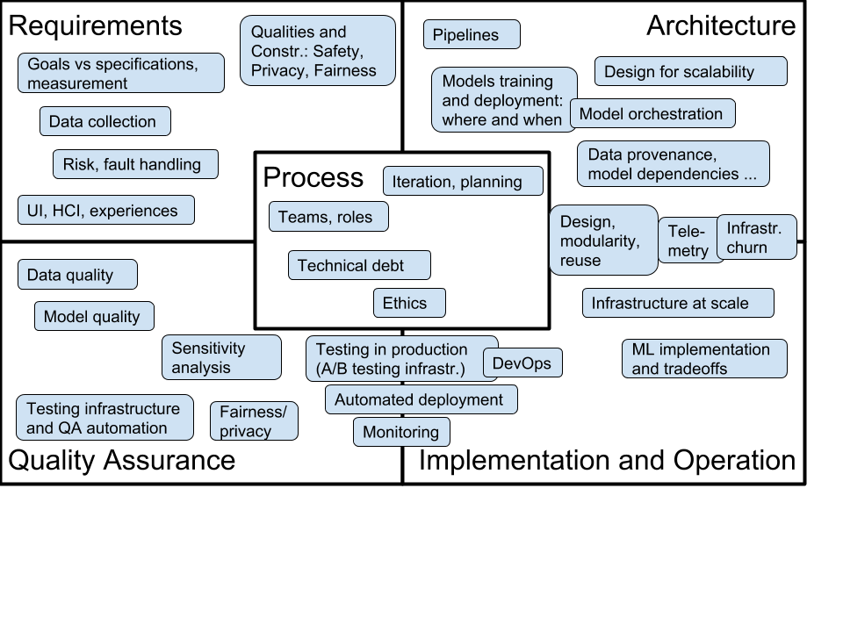
Fall 2019: New Course: Software Engineering for AI-Enabled Systems
What changes with AI?
Requirements
Architecture
Operations
Quality assurance
Process
Going beyond Jupyter notebooks, operating AI-enabled systems in practice at scale
Software engineering view on AI/ML craze
https://ckaestne.github.io/seai/

Slide 6
Case Study

Slide 7
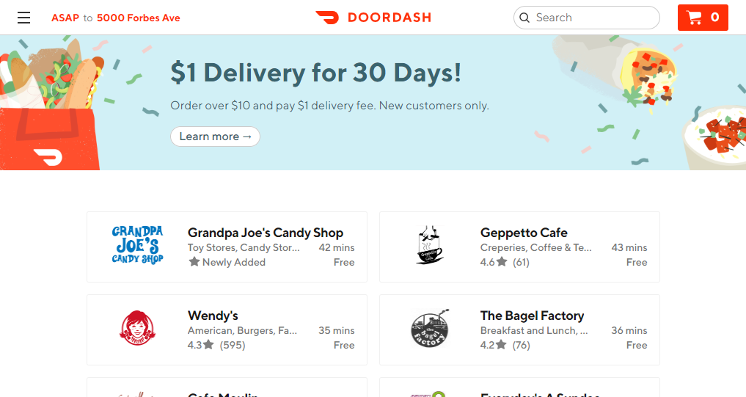

Slide 8
Predicting Delivery Times
What factors may it depend on?
What can be used for learning and prediction?
How to evaluate accuracy?
One model or multiple?

Slide 9
Machine Learning Pipeline

Slide 10
Typical ML Pipeline
Static
Get labeled data
Identify and extract features
Split data into training and evaluation set
Learn model from training data
Evaluate model on evaluation data
Repeat, revising features
With production data
Evaluate model on production data; monitor
Select production data for retraining
Update model regularly

Slide 11
Example Data
RestaurantID | Order | OrderTime | ReadyTime | PickupTime
5 | 5A;3;10;11C;C:No onion | 18:11 | 18:23 | 18:31
…

Slide 12
Feature Engineering
Identify parameters of interest that a model may learn on
Convert data into a useful form
Normalize data
Include context
Remove misleading things
In delivery prediction:

Slide 13
Features?

Slide 14
Feature Extraction
In delivery prediction:
Order time, day of week
Average number of orders in that hour
Order size
Special requests
Order items
Preparation time

Slide 15
Data Cleaning
Removing outliers
Normalizing data
Missing values
…

Slide 16
Data cleaning?

Slide 17
Learning
Build a predictor that best describes an outcome for the observed features
RestaurantID | Order3 | SpecialRequest | DayOfWeek | PreparationTime
5 | yes | yes | 2 | 12
…

Slide 18
Evaluation
Prediction accuracy on learned data vs
Prediction accuracy on unseen data
Separate learning set, not used for training
For binary predictors: false positives vs false negatives, recall, precision
For numeric predictors: average (relative) distance between real and predicted value
For ranking predictors: topK etc

Slide 19
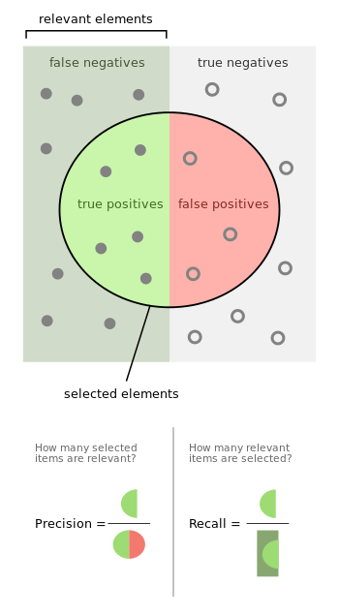
Recall/Precision
Describes accuracy of a model in two (relative) numbers
Recall~: how many useful answers
Precision~: how much noise

Slide 20
Evaluation Data?

Slide 21
Underfitting, Overfitting
Overfitting: Model learns exactly the input data, but does not generalize to unseen data
Underfitting: Model makes very general observations but poorly fits to data
Adjust degrees of freedom in the model to balance between overfitting and underfitting

Slide 22
Overfitting example
contains “love”
romance
contains “laser”
Text | Genre
When the earth stood… | Science fic.
Two households, both alike… | Romance
To Sherlock Holmes she… | Adventure
science fiction adventure
first word = when
second word = the ….
second word = earth …..
science fiction …

Slide 23
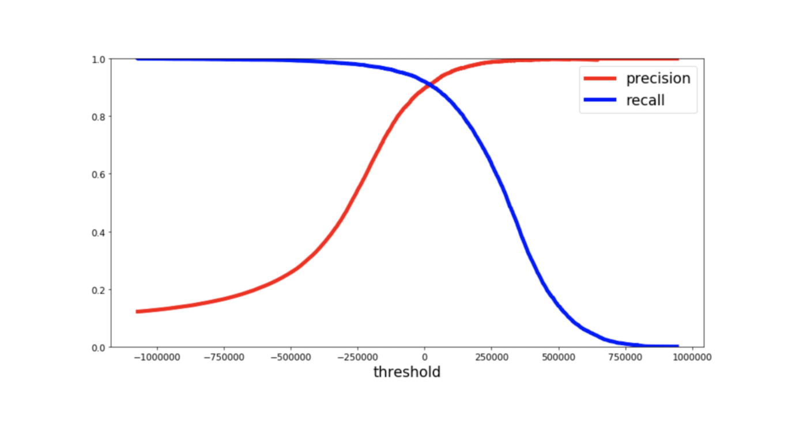
Recall/Precision under different Thresholds

Slide 24
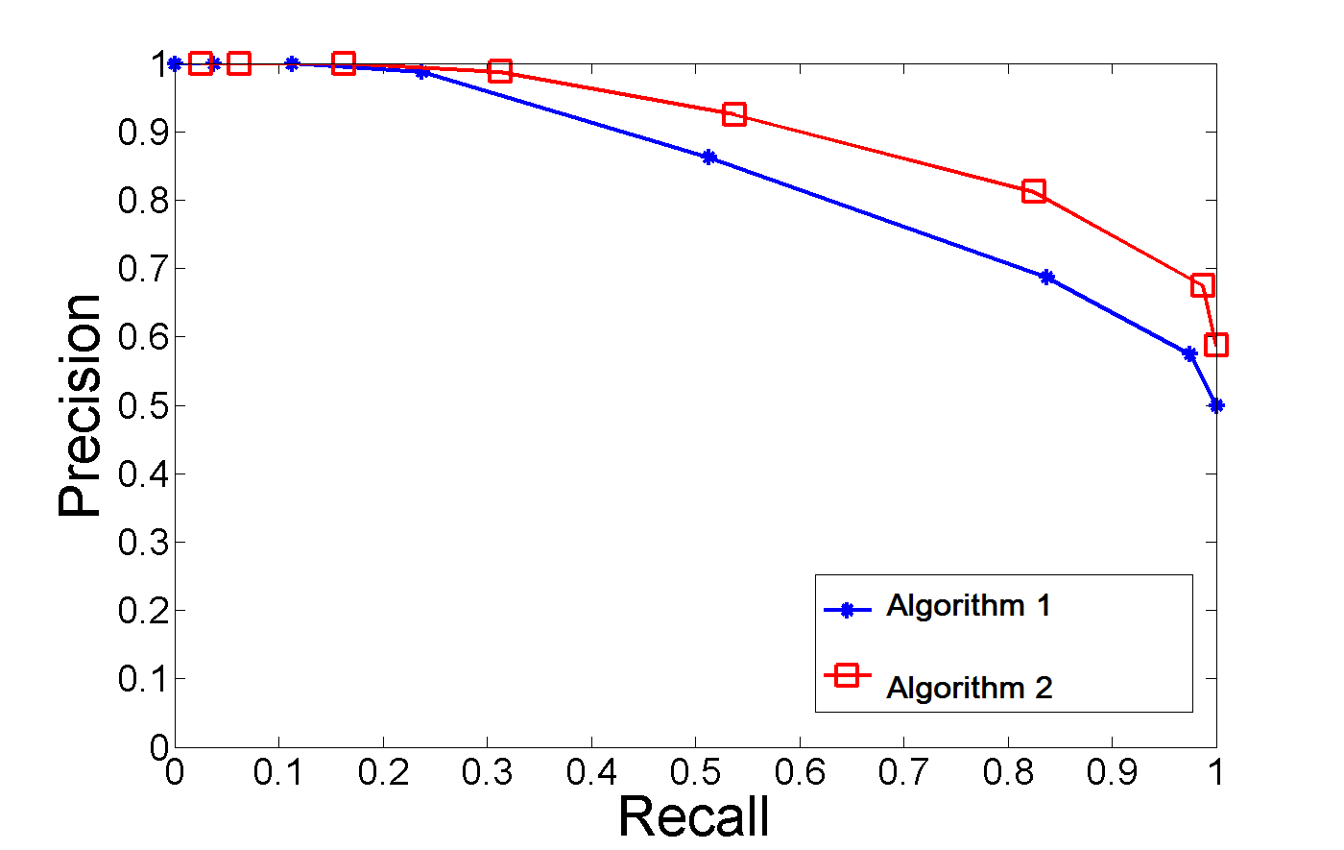
Comparing Recall/Precision under different Thresholds

Slide 25
Learning and Evaluating in Production
Beyond static data sets, build telemetry
Design challenge: identify mistakes in practice
Use sample of live data for evaluation
Retrain models with sampled live data regularly
Monitor performance and intervene

Slide 26
Code vs Data Quality
Functional correctness of source code (specification)
Does the learner correctly implement the math to do the right predictions?
Suitability of data/model for a task (goal optimization)
Is the data representative to learn the underlying relationship?
Is the data sufficient to generalize a well-fitting model?
Is the data/model misleading or biased or noisy?

Slide 27
Data Drift and Feedback Loops

Slide 28
Can predictions influence the delivery times?

Slide 29
What changes in the real-world may influence delivery times?

Slide 30
Can a restaurant game the predictions?

Slide 31
Data Drift and Feedback Loop
Predictions depend on data, data changes
Data may change; changes might be subtle: Data drift
e.g., new restaurants, seasons, restaurant popularity, staff shortage
Predictions can affect user behavior and thus data: feedback loops
e.g., restaurant hiring more cooks in response to demand
Adversaries and gaming
e.g., prioritizing delivery orders during learning period, underreporting preparation times, …

Slide 32
Detecting Data Drift
Test performance on live data, monitor accuracy
anomalies, slow degradation
Test for changes in input data and features
schema conformance
value distribution aligning with distribution in learning set?
various statistical methods
Anticipate, test and monitor!

Slide 33
Detecting Feedback Loops
Deliberate design: Analyze problem and environment for likely feedback loops
Architecture analysis: Which models use outputs of other models?
Perform risk modeling, e.g., fault trees
Think like an adversary
Design thinking, modeling!

Slide 34


Slide 35
Unit Testing for Data

Slide 36
Unit testing for data
Check invariants in static and runtime data
Conformance to schema (bugs!)
Conformance to expected distributions (drift! outliers! attacks!)
Expected relationships within the data (e.g., dependencies or correlations)
Data does not contain unappropriate features (e.g., privacy)
…
Heuristics to check for typical problems…

Slide 37
What to Test?

Slide 38
Versioning of Data and Models
Ensure reproducibility
Treat data and models and configuration like code/binaries – version control, reproducible builds (feature extraction, learning, …)
Document and version parameters (“configuration as code”)
Archive and version models with unique names
Challenge: large data sets, pointer to cloud databases etc

Slide 39
What to Version?

Slide 40
Test ML Pipelines
Test feature extraction code on static data and production data
Code review of model specifications and feature extraction code
Test the effect of stale models
Test against simpler baseline models and heuristics
Test model quality on specific important datasets
Test reproducibility of training
Integration test of full pipeline from data to model

Slide 41
Test Model Deployment
Test that different model variants and versions can be used for different tasks/consumers
Canary testing for model deployment
Test how fast and safely a model can be rolled back
Measure model age, detect staleness
Monitor prediction quality in production
Monitor training and evaluation latency and model size
Further reading: The ML Test Score: A Rubric for ML Production Readiness and Technical Debt Reduction by Eric Breck, Shanqing Cai, Eric Nielsen, Michael Salib, D. Sculley.

Slide 42
Sensitivity Analysis and Fairness

Slide 43
Sensitivity Analysis
Method to detect which model parameters are important
Analysis of a model by testing the model with different inputs
Origin in policy and physics models:
Also “what if”-analysis
e.g., which parameters are really important for high-leverage decisions; where should we focus our energy in discussion and research?
Further reading: Saltelli, Andrea, et al. Global sensitivity analysis: the primer. John Wiley & Sons, 2008.

Slide 44
Sensitivity Analysis: Typical Process
One at a time method:
Pick random values and get output of model
Flip a single feature in all values and get output of model
Observe typical difference between two values
Repeat for other features
Random sampling:
Learn a simpler (interpretable) model from random samples
Identify important model parameters
Many other sampling strategies exist to cover large spaces (see “design of experiments”)
Some features will have no or little influence, some parameters very consistent large effects, others very noisy effects

Slide 45




Exponential number!
Individual Options
Interactions
1
0
1
1
1
0
1
0
1
0
1
1
0
1
0
1
1
0
1
0
1
1
0
1
1
0
1
1
0
1
1
1
0
0
1
0
0
0
1
1
0
1
0
0
0
0
1
0
1
0
0
0
1
0
0
1
Perf.
10.3
55.8
21.9
60.1
59.3
29.3
45.6
Configurations
β₀
β₁
β₂
β₃
β₄
β₅
β₆
β₇
β₈
Error:
36.5
-24.3
15.3
-2.5
5.4
0.3
21%
30.4
-21.1
5.3
-2.4
3.5
0.2
26.1
-5.4
0.01
6%
p = β₀ + β₁*index + β₂*encr + β₃*compr + …
p = 36.5 – 24.3*index + 15.3*encr – 2.5*compr + …
[Siegmund,FSE’15]

Slide 46
What Features are Most Useful?

Slide 47
Robustness
How much does a model depend on a specific operationalization of a feature?
can we measure delivery time with a different method and still get similar results?
does our feature “gender”/”income” need to be very accurate for our model to work effectively?
how sensitive is our model to outliers?
Evaluate model accuracy with different features or versions of feature extractors

Slide 48
Example Data Analytics Question:
What encourages better
Dependency Management Practices?
A. Trockman, S. Zhou, C. Kästner, and B. Vasilescu. Adding Sparkle to Social Coding: An Empirical Study of Repository Badges in the npm Ecosystem. In Proceedings of the 40th International Conference on Software Engineering (ICSE), New York, NY: ACM Press, May 2018.

Slide 49
Example Data Analytics Question:
What encourages better
Dependency Management Practices?
Many ways to operationalize “project popularity”, e.g., stars or downloads. Test whether results are robust to different operationalizations
A. Trockman, S. Zhou, C. Kästner, and B. Vasilescu. Adding Sparkle to Social Coding: An Empirical Study of Repository Badges in the npm Ecosystem. In Proceedings of the 40th International Conference on Software Engineering (ICSE), New York, NY: ACM Press, May 2018.

Slide 50
Fairness
Sensitivity analysis with regard to sensitive parameters
gender, race, …
Evaluate loss in accuracy if sensitive features removed
Careful with correlation
A is sensitive, not used for learning
B correlates with A, B used for learning
Model likely still biased for A
Lots of attention recently, lots of research

Slide 51
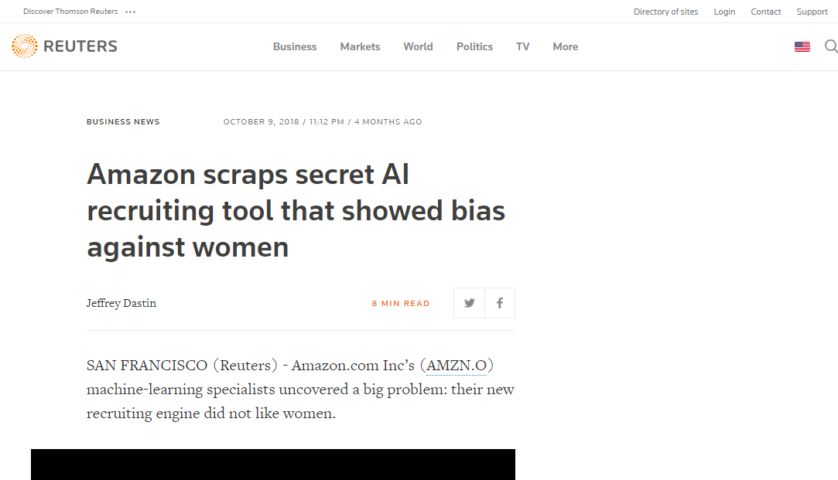

Slide 52
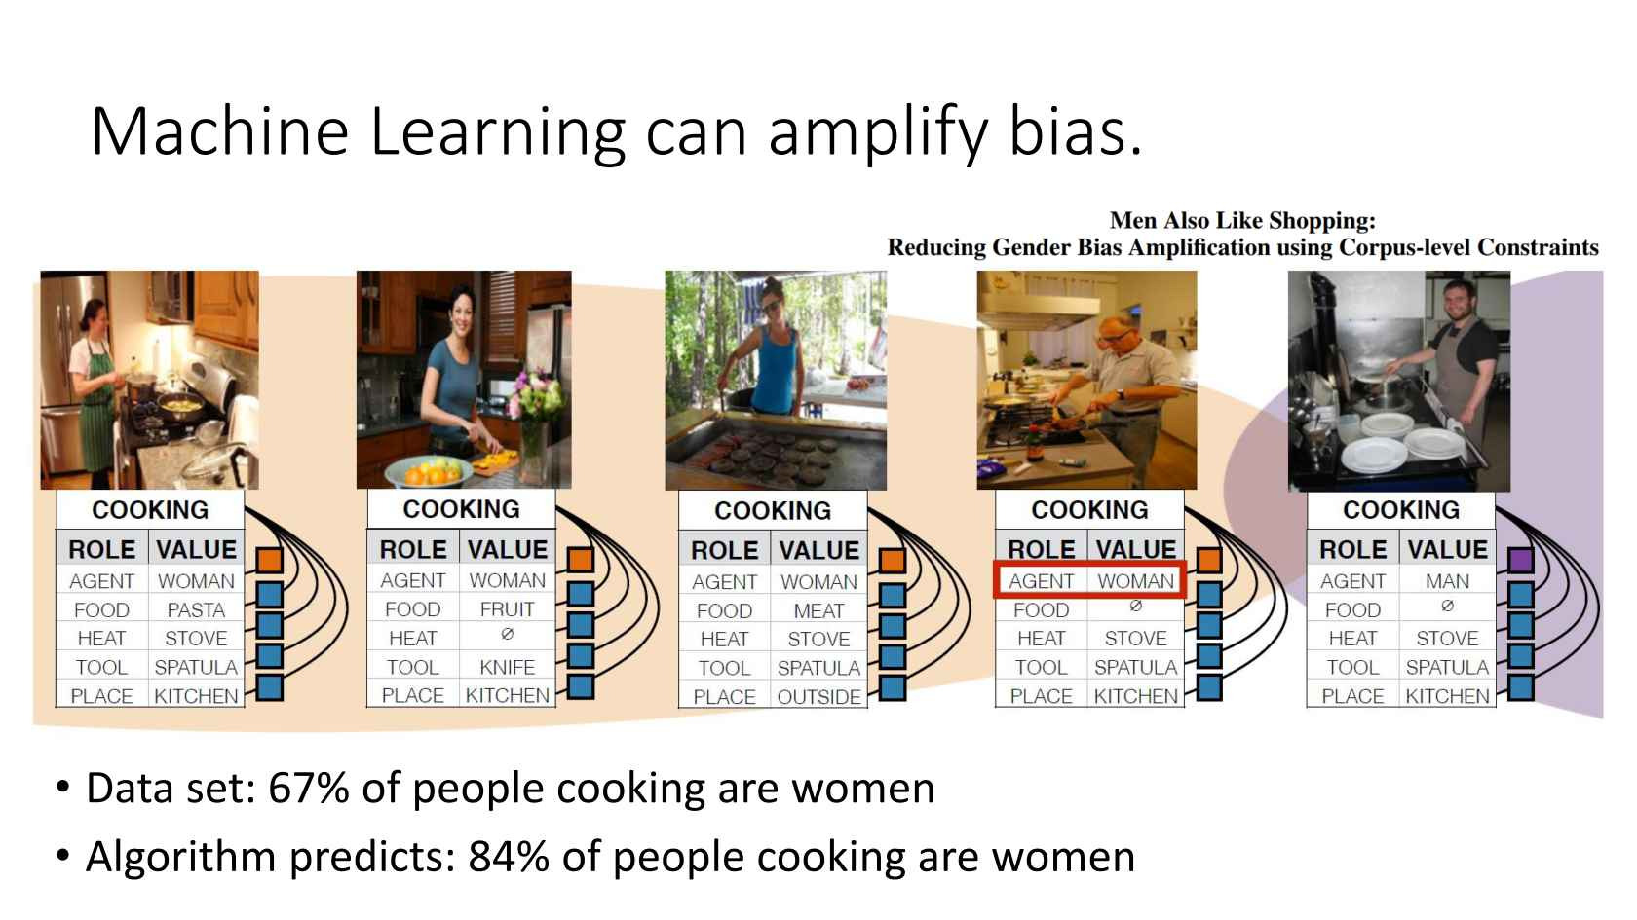
https://www.infoq.com/presentations/unconscious-bias-machine-learning

Slide 53
Fairness Issues?

Slide 54
Anomaly Detection

Slide 55
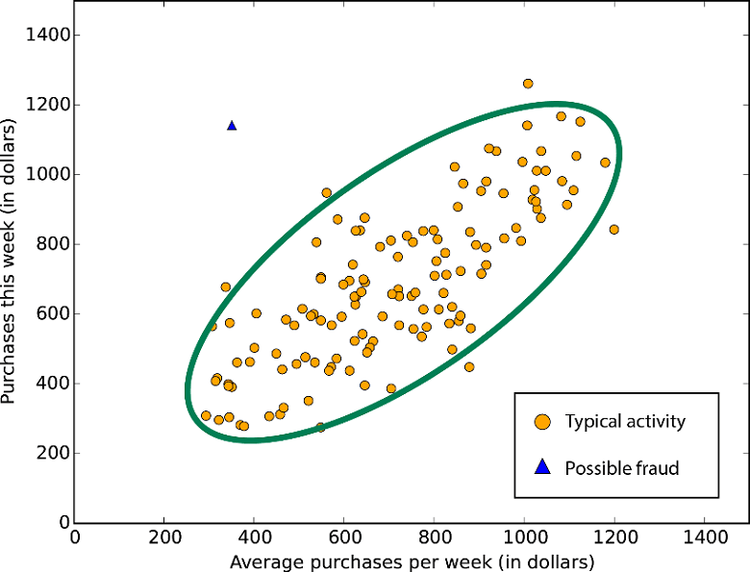

Slide 56
Anomaly Detection
Find outliers in dataset
point anomalies
contextual anomalies
collective anomalies
Anomalies can indicate bugs, attacks, new requirements, data drift, …
intrusion detection
fraud detection
medical/health anomaly detection
industrial damage detection
…
Chandola, Varun, Arindam Banerjee, and Vipin Kumar. "Anomaly detection: A survey." ACM computing surveys (CSUR) 41.3 (2009): 15.

Slide 57
Anomaly detection techniques
Supervised vs unsupervised learning
Various learning techniques
classification based
nearest neighbor
clustering based
statistical techniques
information-theoretic techniques
spectral techniques
Chandola, Varun, Arindam Banerjee, and Vipin Kumar. "Anomaly detection: A survey." ACM computing surveys (CSUR) 41.3 (2009): 15.

Slide 58
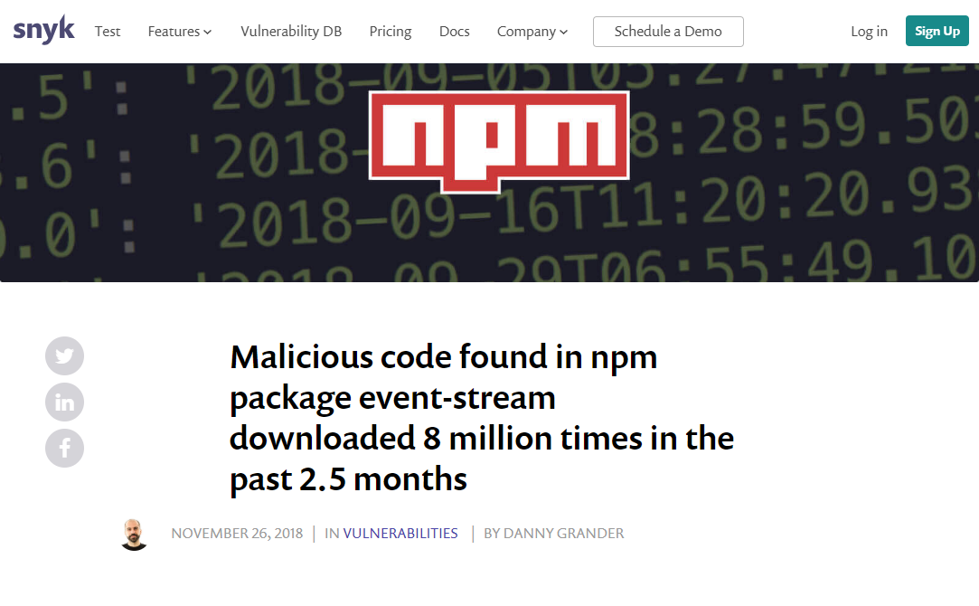

Slide 59
Anomaly Detection?

Slide 60
More QA for ML/AI

Slide 61
Risk Analysis
AI components make mistakes
What are the consequences of mistakes? Worst case outcomes?
How can they be mitigated?
How reliable are those mitigation strategies?
Requirements and risk analysis
Review of requirements
Think like an adversary
Fault tree analysis

Slide 62
Test Coverage
Coverage of the input space in training data?
Coverage of connections in neural network?
Representativeness of learning data or static testing data of real-world data?

Slide 63
Hyperparameter Tuning
Many learning techniques have parameters
Parameters can influence performance significantly
Tuning techniques exist, often more effective than changing modeling technique
Track model parameters like code/configuration

Slide 64
Fall 2019: New Course: Software Engineering for AI-Enabled Systems
What changes with AI?
Requirements
Architecture
Operations
Quality assurance
Process
Going beyond Jupyter notebooks, operating AI-enabled systems in practice at scale
Software engineering view on AI/ML craze
https://ckaestne.github.io/seai/

Slide 65
Summary
AI-enabled systems optimize for goals; no clear specification/oracle
Learning+evaluation on static data set vs live data
Key problems: data drift, feedback loops, adversaries
Evaluation of data and model quality, testing of entire pipelines
Sensitivity analysis and anomaly detection are powerful tools

